Slide 1


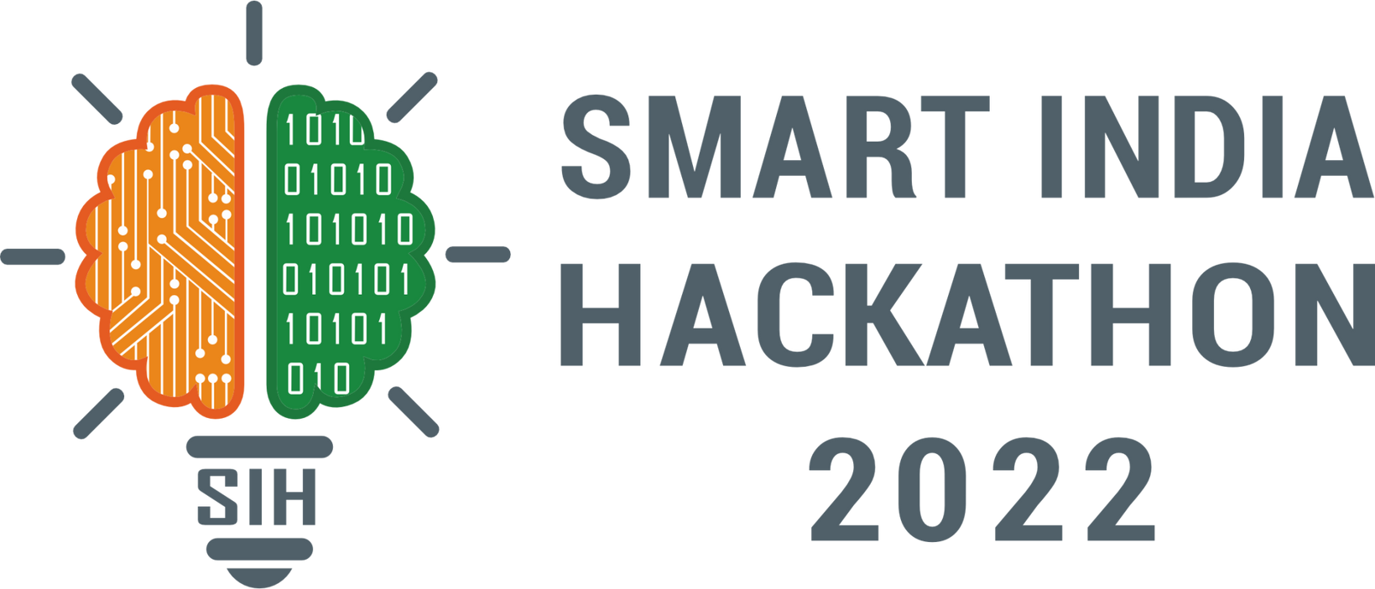
SMART INDIA HACKATHON 2025
TITLE PAGE
Problem Statement ID – 25104
Problem Statement Title- Language Agnostic Chatbot
Theme- Smart Education
PS Category- Software
Team ID-
Team Name- Algo Yodhas

Slide 2
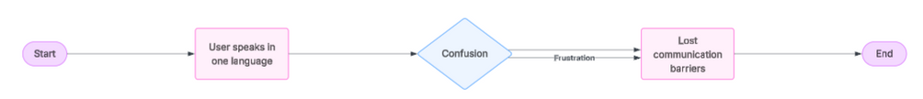
The AI Bridge for India's Languages: Samvaad AI
Algo Yodhas
IDEA/ SOLUTION :-
Samvaad AI is an AI-powered platform for multilingual communication and cultural understanding in India.
It goes beyond simple translation to capture tone, intent, and respect.
It enables real-time multilingual chat.
The platform includes a cultural sensitivity layer that explains language nuances.
It supports both voice and text for accessibility.
It is platform-agnostic, working on any device.
The technology is built on datasets tuned for Indian languages and contexts.
Its core purpose is to connect humans, not just translate
“Samvaad doesn’t just translate. It connects humans.”
PROBLEM STATEMENT:-
There are significant communication gaps in India due to its 22 official languages and more than 19,000 dialects.
Current tools result in literal translations, which are frequently unclear and occasionally offensive.
Business, healthcare, education, and governance are all hampered by poor communication.
2
Notes:
2

Slide 3
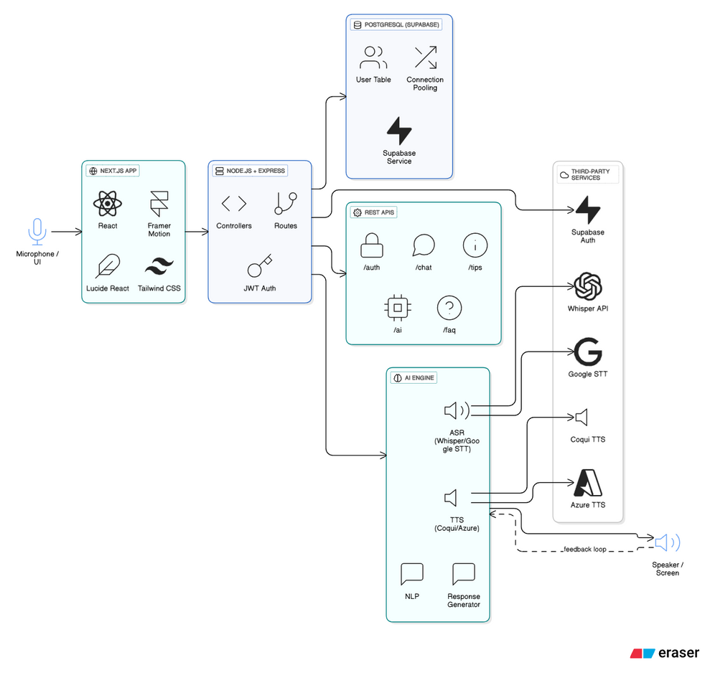




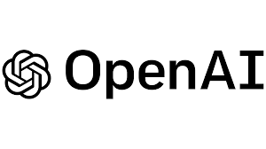

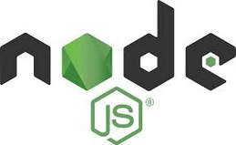

TECHNICAL APPROACH
Algo Yodhas
Frontend: Next.js, Framer Motion, Lucide React, Tailwind-style CSS
Backend: Node.js + Express.js, RESTful APIs, JWT Auth
Database: PostgreSQL (Supabase) with connection pooling
APIs: /auth, /chat, /tips, /ai, /faq
AI Integration: Speech-to-Text (ASR), NLP, Response Generator, Text-to-Speech
3
Notes:
3

Slide 4
FEASIBILITY AND VIABILITY
Algo Yodhas
Feasibilty Analysis:
Technical: Modern stack (Next.js, Node.js, Supabase, AI models) ensures scalability and reliability.
Financial: Minimal upfront costs; scalable cloud infra reduces long-term expenses.
Market: Rising demand for multilingual AI assistants in India; untapped regional language market creates strong adoption potential.
Operational: Simple UI/UX for end-users, easy onboarding, and low maintenance requirements.
Development Complexity: Medium to high; requires seamless AI integration, real-time voice processing, and secure authentication mechanisms.
Strategies to Overcome Challenges:
Use pre-trained multilingual AI models with fine-tuning.
Hybrid cloud approach to balance cost + performance.
Implement strong encryption & compliance with data laws.
Scalable architecture (load balancers, caching, optimized DB).
Awareness campaigns and pilot programs in target regions.
Viability Analysis:
Financial Viability: Low infra cost, freemium model for scaling.
Social Viability: Bridges digital divide, supports inclusivity.
Sustainability Viability: Open-source + modular stack reduces long-term overhead.
Adoption Viability: Aligned with Digital India, strong government + institutional use cases.
Challenges and Risks:
Real-time voice recognition across multiple languages.
Maintaining accuracy in regional dialects.
Ensuring data privacy and user security.
Scaling database for high-volume concurrent users.
Building trust and adoption in rural communities.
4
Notes:
4

Slide 5
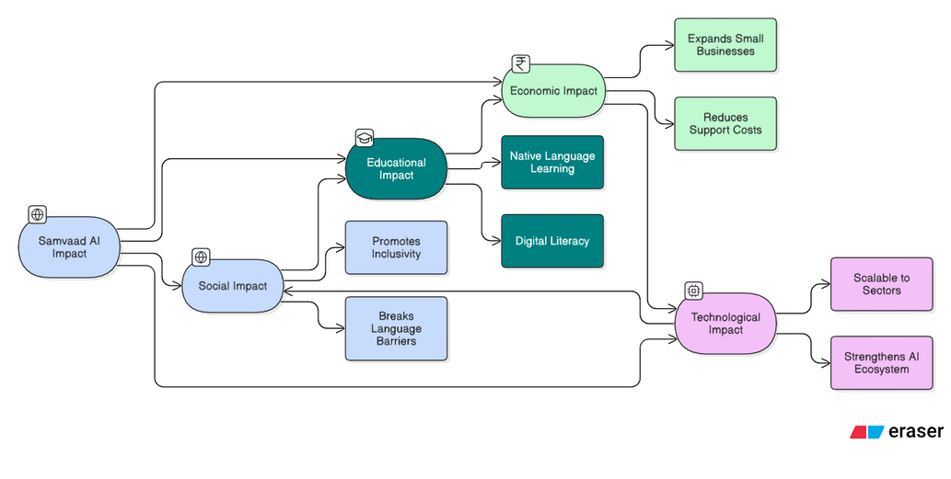
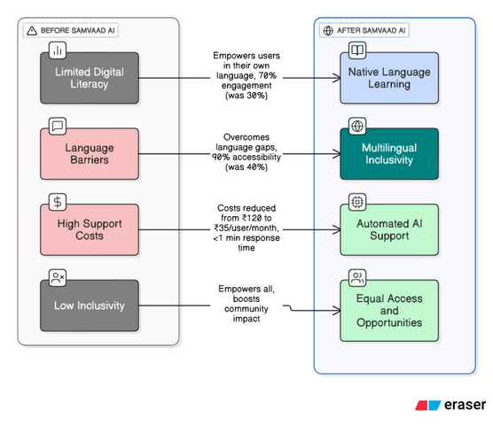
IMPACT AND BENEFITS
Algo Yodhas
1.) Social Impact :
Breaks language barriers across India.
Promotes inclusivity in rural & underserved communities.
2.) Educational Impact:
Provides learning support in native languages.
Improves digital literacy & knowledge access.
3.) Economic Impact:
Expands SME and startup market reach.
Cuts customer support costs via automation.
4.) Technological Impact:
Strengthens India’s multilingual AI ecosystem.
Scalable for healthcare, governance, and businesses.
5
Notes:
5

Slide 6



RESEARCH AND REFERENCES
Algo Yodhas
Research:-
40% of rural users in India face digital barriers due to lack of regional language support (IAMAI, 2023)
65% of Indians prefer accessing digital platforms in their native language (Google–KPMG Report)
Conversational AI adoption is growing at a 30% CAGR till 2027 (Gartner, 2023)
AI-driven multilingual solutions improve customer engagement by 25–35% (Deloitte, 2022)
Research:-
IAMAI Report (2023) – Internet in India
Google & KPMG – Indian Languages: The Digital Divide
Gartner (2023) – Conversational AI Market Trends
Deloitte Insights (2022) – Future of Conversational AI
IEEE Access (2022) – Multilingual Conversational AI Systems
6
Notes:
6

